Slide 1
How to temporarily deactivate certain pickup locations for hold requests
Yoel Kortick
Senior Librarian

Slide 2
Introduction
Example before unchecking "Has hold shelf"
Uncheck "Has hold shelf" in circulation desks
Example after unchecking "Has hold shelf"

Slide 3
Introduction

Slide 4
Introduction
In the example here we will temporarily remove the request pickup location “Music Library” from the list of libraries whiuch appear as a pickup location in both Alma and Primo when making a hold request.
The removal is done by unchecking the “Has hold shelf” checkbox in the circulation desks of the library.
To return the situation to as it was before the removal, the staff user merely needs to recheck “Has hold shelf” in the circulation desk.

Slide 5
Example before unchecking "Has hold shelf"

Slide 6
Example before unchecking "Has hold shelf"
On the next slide in Alma a request is made for patron Alicia Chen for title “City women : contemporary Taiwan women writers”
The libraries which appear as pickup locations are:
Main Library
Music Library
Art Library
Engineering Library
Library of Chinese Studies

Slide 7
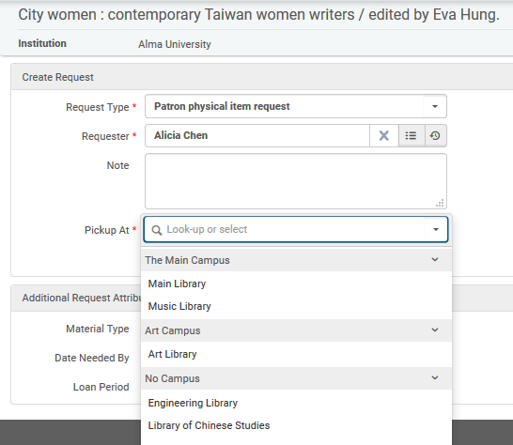
Example before unchecking "Has hold shelf"

Slide 8
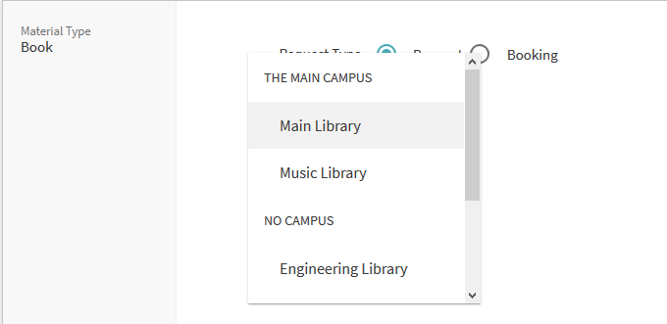
Example before unchecking "Has hold shelf"
The same libraries appear when Alicia logs into Primo and requests the same item

Slide 9
Uncheck "Has hold shelf" in circulation desks

Slide 10
Uncheck "Has hold shelf" in circulation desks
The institution wants to remove “Music Library” from the list of pickup locations
We will remove “Has hold shelf” from the circulation desks of the library
Navigate to the Circulation Desks at: Configuration > Choose Art Library > Fulfillment > Circulation Desks

Slide 11
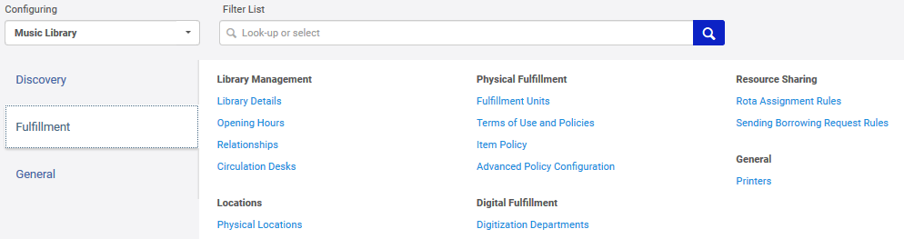
Uncheck "Has hold shelf" in circulation desks

Slide 12
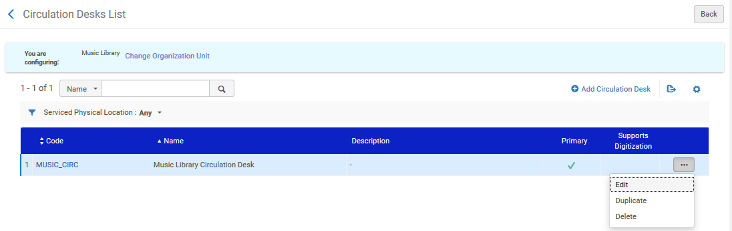
Uncheck "Has hold shelf" in circulation desks
Edit the circulation desks

Slide 13
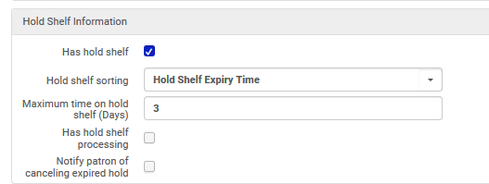
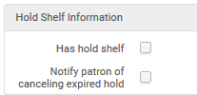
Uncheck "Has hold shelf" in circulation desks
Uncheck “Has hold shelf”
Before
Before

Slide 14
Example after unchecking "Has hold shelf"

Slide 15
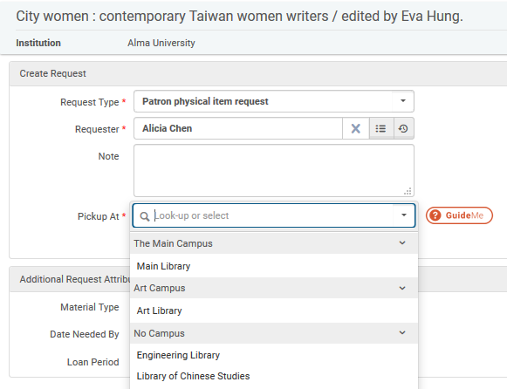
Example after unchecking "Has hold shelf"
“Music Library” no longer appears when making a request in Alma

Slide 16
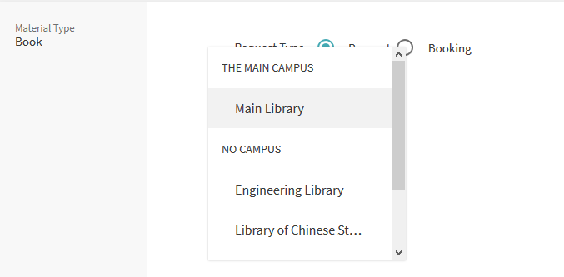
Example after unchecking "Has hold shelf"
“Music Library” no longer appears when making a request in Primo

Slide 17
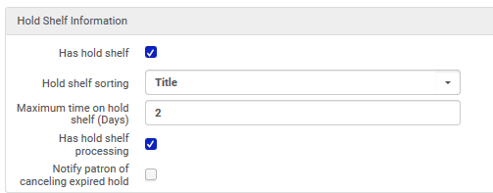
Example after unchecking "Has hold shelf"
To return the Music Library to the list of library pickup locations merely recheck “Has Hold Shelf” in the circulation desk.

Slide 18
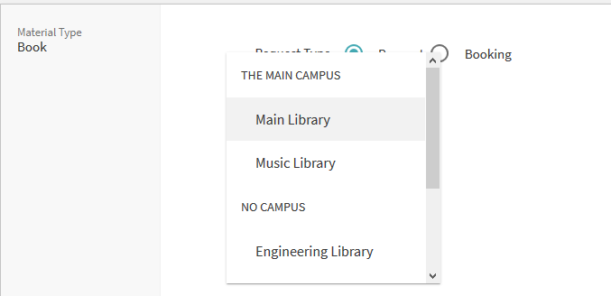
Example after unchecking "Has hold shelf"
The Music Library has returned to the list of library pickup locations

Slide 19
Thank you!
xxx@exlibrisgroup.com

